Slide 1
Open System Interconnection (OSI) model
The Open System Interconnection (OSI) model defines a networking framework to implement protocols in seven layers. The OSI Model is neither tangible nor perform any functions in the networking process. It is a conceptual framework so we can better understand complex interactions that are happening.
The OSI model takes the task of inter-networking and divides that up into what is referred to as a vertical stack that consists of the following 7 layers:
Physical (Layer 1)
Data Link (Layer 2)
Network (Layer 3)
Transport (Layer 4)
Session (Layer 5)
Presentation (Layer 6)
Application (Layer 7)

Slide 2
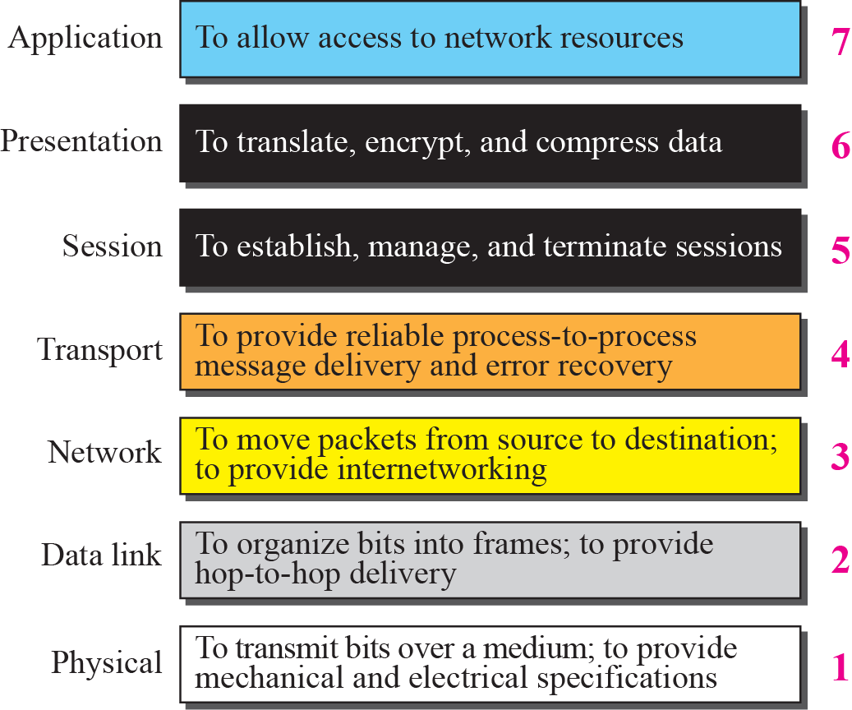
TCP/IP Communication Model

Slide 3
Physical (Layer 1)
Conveys the bit stream - electrical impulse, light or radio signal — through the network at the electrical and mechanical level. It provides the hardware means of sending and receiving data
Fast Ethernet, RS232, and ATM are protocols with physical layer components.
Physical Examples: Ethernet, FDDI, B8ZS, V.35, V.24, RJ45.
Data Link (Layer 2)
Data packets are encoded and decoded into bits. It furnishes transmission protocol knowledge and management and handles errors in the physical layer, flow control and frame synchronization. The data link layer is divided into two sub layers: The Media Access Control (MAC) layer and the Logical Link Control (LLC) layer. The MAC sub layer controls how a computer on the network gains access to the data and permission to transmit it. The LLC layer controls frame synchronization, flow control and error checking.
Data Link examples: Includede PPP, FDDI, ATM, IEEE 802.5/ 802.2, IEEE 802.3/802.2, HDLC, Frame Relay.

Slide 4
Network (Layer 3)
It provides switching and routing technologies, creating logical paths, known as virtual circuits, for transmitting data from node to node. It also addresses internetworking, error handling, congestion control and packet sequencing.
Layer 3 examples include: AppleTalk, DDP, IP, IPX.
Transport (Layer 4)
It provides transparent transfer of data between end systems, or hosts, and is responsible for end-to-end error recovery and flow control. It ensures complete data transfer.
Layer 4 examples include: SPX, TCP, UDP.
Session (Layer 5)
It establishes, manages and terminates connections between applications. The session layer sets up, coordinates, and terminates conversations, exchanges, and dialogues between the applications at each end. It deals with session and connection coordination.
Layer 5 examples include: NFS, NetBios names, RPC, SQL.

Slide 5
Presentation (Layer 6)
It transform data into the form that the application layer can accept. It formats and encrypts data to be sent across a network, providing freedom from compatibility problems. It is sometimes called the syntax layer.
Layer 6 examples: encryption, ASCII, EBCDIC, TIFF, GIF, PICT, JPEG, MPEG, MIDI.
Application (Layer 7)
Everything at this layer is application-specific. This layer provides application services for file transfers, e-mail, and other network software services. Telnet and FTP are applications that exist entirely in the application level.
Layer 7 examples: WWW browsers, NFS, SNMP, Telnet, HTTP, FTP
Two similar projects from the late 1970's were merged in 1983 to form the Basic Reference Model for Open Systems Interconnection standard (the OSI model). It was published in 1984 as standard ISO 7498.

Slide 6
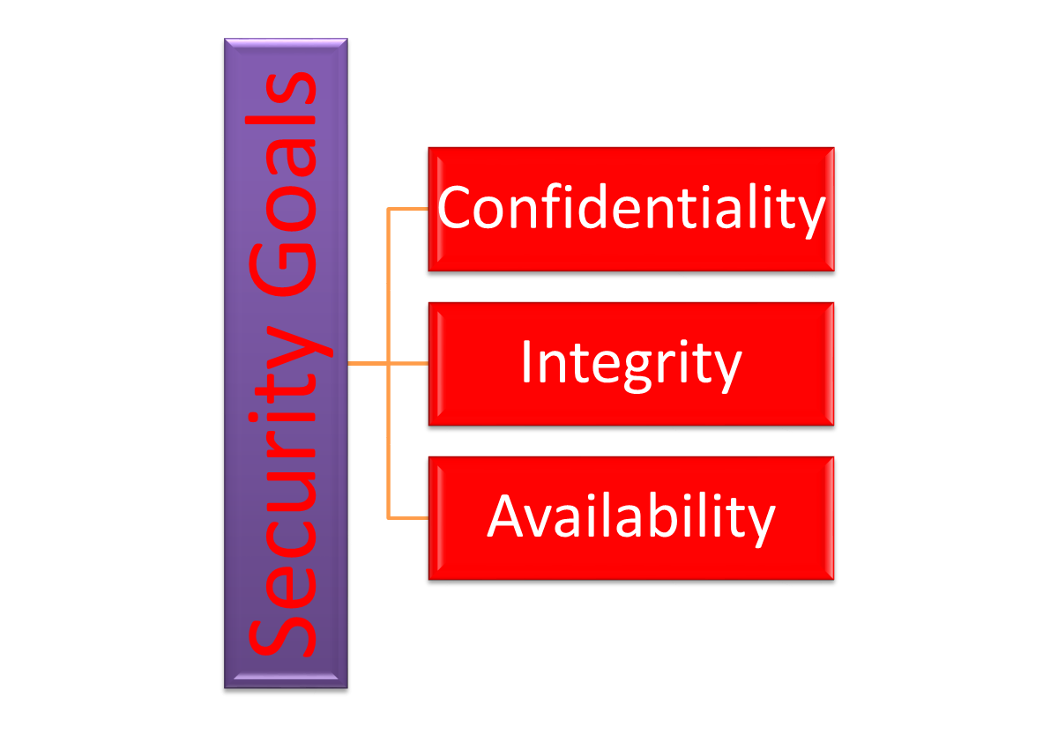
Taxonomy of Security Goals
Notes:
1.#

Slide 7
Confidentiality & Integrity
Confidentiality: is probably the most common aspect of information security. We need to protect our confidential information. An organization needs to guard against those malicious actions that endanger the confidentiality of its information.
Integrity: Information needs to be changed constantly. Integrity means that changes need to be done only by authorized entities and through authorized mechanisms.
Notes:
1.#

Slide 8
Availability
Availability: This is the third component of information security. The information created and stored by an organization needs to be available to authorized entities.
Information needs to be constantly changed, which means it must be accessible to authorized entities.
SECURITY ATTACKS
Attacks Threatening Confidentiality
Attacks Threatening Integrity
Attacks Threatening Availability
Passive versus Active Attacks
Notes:
1.#

Slide 9
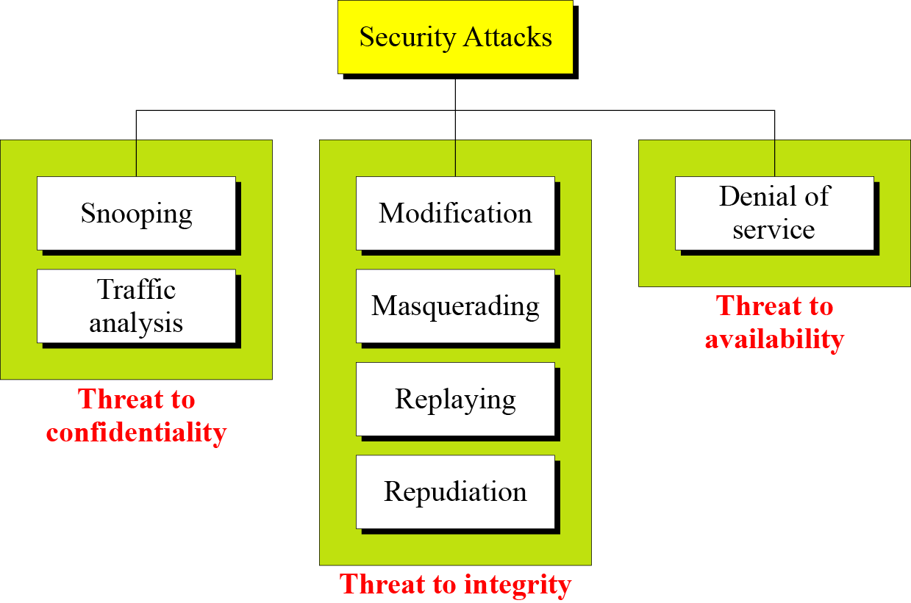
Taxonomy of attacks with relation to security goals
Notes:
1.#

Slide 10
Attacks Threatening Confidentiality
Snooping refers to unauthorized access to or interception of data.
Traffic analysis refers to obtaining some other type of information by monitoring online traffic.
Modification means that the attacker intercepts the message and changes it.
Masquerading or spoofing happens when the attacker impersonates somebody else.
Notes:
1.#

Slide 11
Attacks Threatening Integrity
Replaying means the attacker obtains a copy
of a message sent by a user and later tries to replay it.
Repudiation means that sender of the message might later deny that she has sent the message; the receiver of the message might later deny that he has received the message.
Denial of service (DoS) is a very common attack. It may slow down or totally interrupt the service of a system.
Notes:
1.#

Slide 12
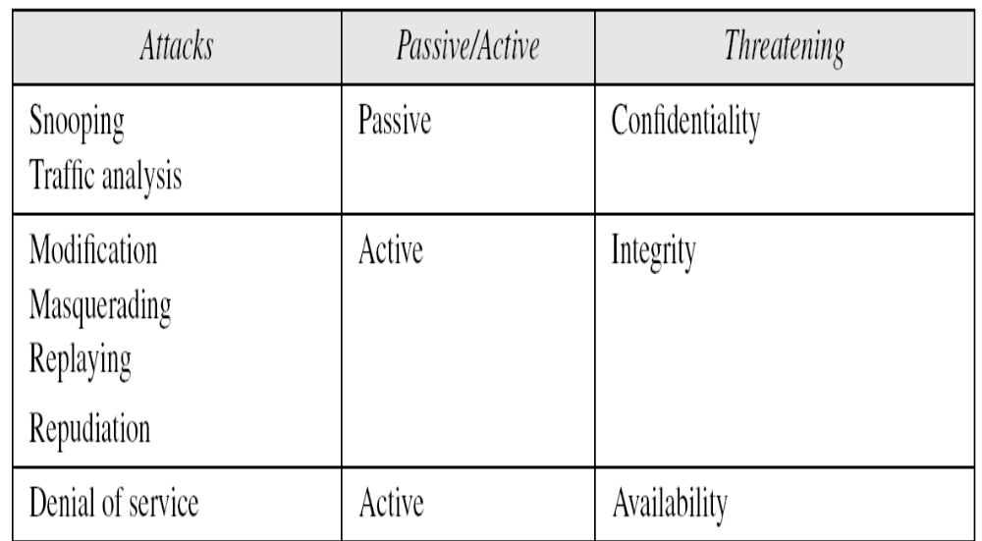
Passive Versus Active Attacks
Categorization of passive and active attacks
Notes:
1.#

Slide 13
SERVICES AND MECHANISMS
International Telecommunication Union- Telecommunication (ITU-T) provides some security services and some Security mechanisms to implement those services. Security services and mechanisms are closely related because a mechanism or combination of mechanisms are used to provide a service.
Topics to be discussed are :
Security Services
Security Mechanism
Relation between Services and Mechanisms
Notes:
1.#

Slide 14
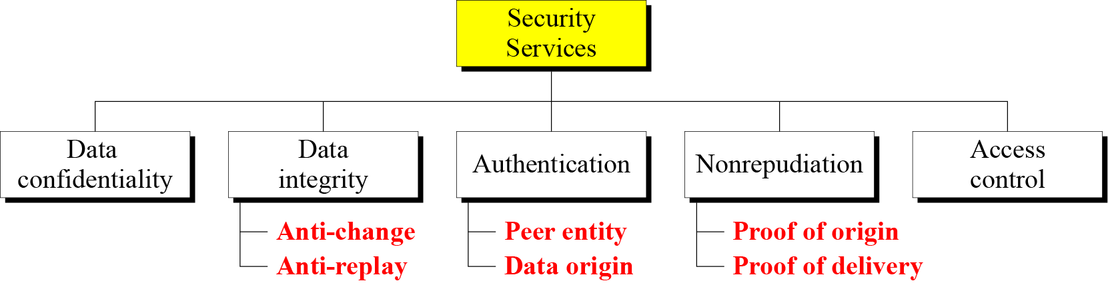
Security Services
Figure 1.3 Security services
Notes:
1.#

Slide 15
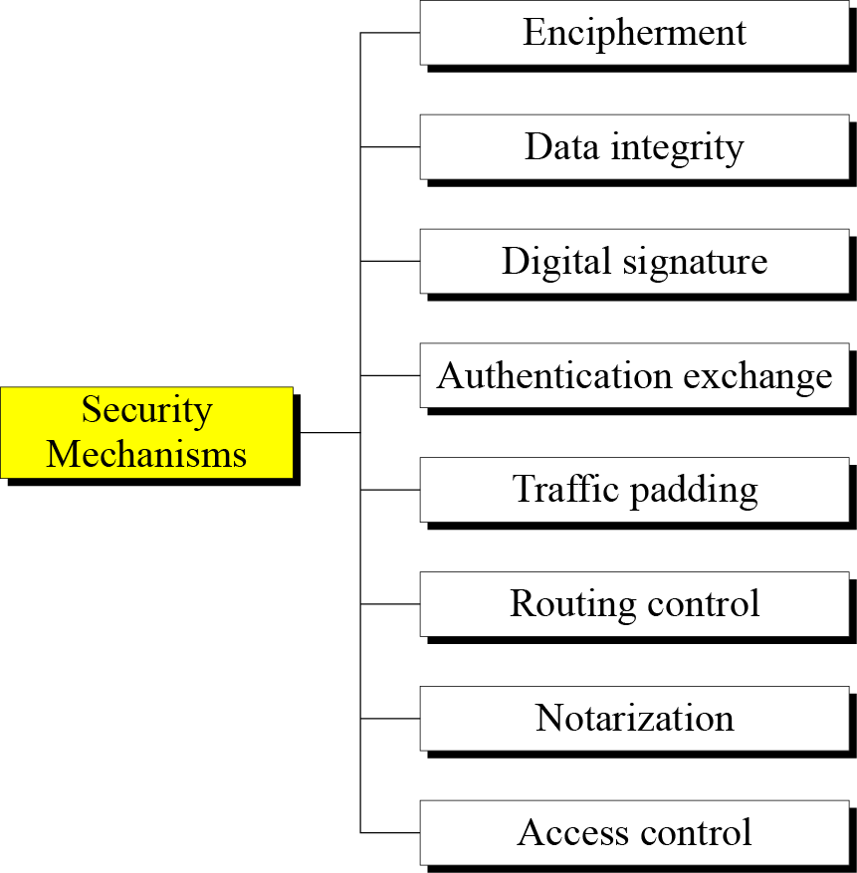
Security Mechanism
Notes:
1.#

Slide 16
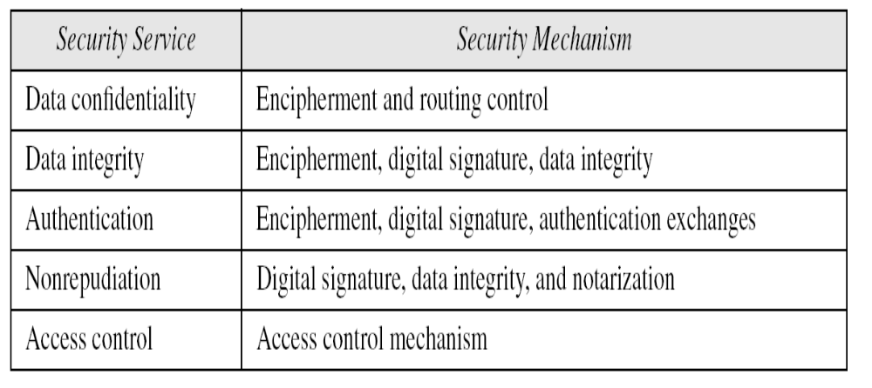
Relation between Services and Mechanisms
Relation between security services and mechanisms
Notes:
1.#

Slide 17
TECHNIQUES
Mechanisms discussed in the previous sections are only theoretical recipes to implement security. The actual implementation of security goals needs some techniques. Two techniques are prevalent today:
Cryptography
Steganography
Notes:
1.#

Slide 18
Cryptography & Steganography
Cryptography, a word with Greek origins, means “secret writing.” However, we use the term to refer “ the science and art of transforming messages to make them secure and immune to attacks” .
The word steganography, with origin in Greek, means “covered writing,” in contrast with cryptography, which means “secret writing.”
Notes:
1.#

Slide 19
SECURITY SERVICES
X.800:
  “a service provided by a protocol layer of communicating open systems, which ensures adequate security of the systems or of data transfers”
RFC 2828:
  “a processing or communication service provided by a system to give a specific kind of protection to system resources”
Notes:
State here a couple of definitions of “security services” from relevant standards. X.800 defines a security service as a service provided by a protocol layer of communicating open systems, which ensures adequate security of the systems or of data transfers. Perhaps a clearer definition is found in RFC 2828, which provides the following definition: a processing or communication service that is provided by a system to give a specific kind of protection to system resources; security services implement security policies and are implemented by security mechanisms.

Slide 20
Security Services (X.800)
Authentication - assurance that communicating entity is the one claimed
  have both peer-entity & data origin authentication
Access Control - prevention of the unauthorized use of a resource
Non-Repudiation - protection against denial by one of the parties in a communication
Data Confidentiality –protection of data from unauthorized disclosure
Data Integrity - assurance that data received is as sent by an authorized entity
Availability – resource accessible/usable
Notes:
This list is taken from Stallings Table 1.2 which provides details of the 5 Security Service categories and the 14 specific services given in X.800.
This list includes the various "classic" security services which are traditionally discussed. Note there is a degree of ambiguity as to the meaning of these terms, and overlap in their use. The broad service categories are:
authentication is concerned with assuring that a communication is authentic. Two specific authentication services are defined in X.800: Peer entity authentication: provides corroboration of the identity of a peer entity in an association; and Data origin authentication: provides corroboration of the source of a data unit.
access control is the ability to limit and control the access to host systems and applications via communications links.
confidentiality is the protection of transmitted data from passive attacks, and the protection of traffic flow from analysis.
integrity assures that messages are received as sent, with no duplication, insertion, modification, reordering, replay, or loss.
availability is the property of a system / resource being accessible and usable upon demand by an authorized system entity, according to performance specifications for the system.

Slide 21
Security Mechanisms (X.800)
specific security mechanisms:
  encipherment, digital signatures, access controls, data integrity, authentication exchange, traffic padding, routing control, notarization
pervasive security mechanisms:
  trusted functionality, security labels, event detection, security audit trails, security recovery
Notes:
Some examples of mechanisms from X.800. Note that the “specific security mechanisms” are protocol layer specific, whilst the “pervasive security mechanisms” are not. We will meet some of these mechanisms in much greater detail later.
See Stallings Table 1.3 for details of these mechanisms in X.800, and Table 1.4 for the relationship between services and mechanisms.

Slide 22
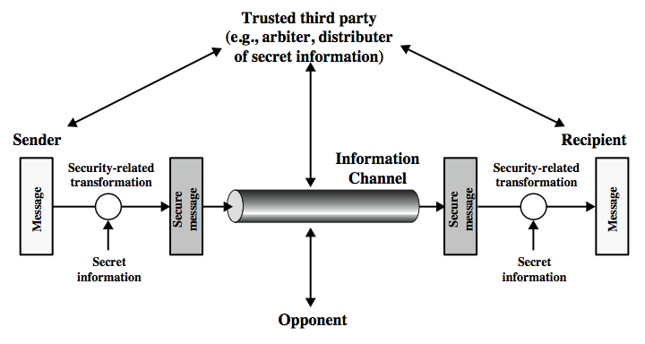
Model for Network Security
Notes:
In considering the place of encryption, its useful to use the following two models from Stallings section 1.6.
The first, illustrated in Figure 1.4, models information being transferred from one party to another over an insecure communications channel, in the presence of possible opponents. The two parties, who are the principals in this transaction, must cooperate for the exchange to take place. They can use an appropriate security transform (encryption algorithm), with suitable keys, possibly negotiated using the presence of a trusted third party. Parts One through Four of this book concentrates on the types of security mechanisms and services that fit into the model shown here.

Slide 23
Basic terminology
Plaintext: original message to be encrypted
Ciphertext: the encrypted message also known as Cryptogram
Enciphering or encryption: the process of converting plaintext into ciphertext
Encryption algorithm: performs encryption
  Two inputs: a plaintext and a secret key

Slide 24
Deciphering or decryption: recovering plaintext from ciphertext
Decryption algorithm: performs decryption
  Two inputs: ciphertext and secret key
Secret key: same key used for encryption and decryption
  Also referred to as a symmetric key

Slide 25
cryptographic system : a scheme for encryption and decryption
Cryptography: Art and science of studying and designing a cryptosystem.
Cryptanalysis: science of studying attacks against cryptographic systems
Cryptology: cryptography + cryptanalysis

